Slide 1
Cloudy
Accurate simulation of physical processes at the atomic & molecular level
“universal fitting formulae” to atomic processes fail when used outside realm of validity, and are not used
Assumptions:
energy is conserved
(usually) atomic processes have reached steady state
Limits:
Kinetic temperature 2.7 K < T < 10¹⁰ K
No limits to density (low density limit, LTE, STE)
Radiation field 10 m to 100 MeV

Slide 2
Simultaneous solution of
Gas ionization
From ionization balance equations
Chemistry
Large network based on UMIST
Gas kinetic temperature
Heating and cooling
Grain physics
Charging, CX, photoejection, quantum heating
The observed spectrum
Radiative transport

Slide 3
Cloudy and its physics
Osterbrock & Ferland 2006, Astrophysics of Gaseous Nebulae and Active Galactic Nuclei, 2nd edition (AGN3)
Ferland+2013, Rev Mex 49, 137, The 2013 Release of Cloudy
Ferland 2003, ARA&A, 41, 517, Quantitative Spectroscopy of Photoionized Clouds

Slide 4
Some applications to astronomy
Hamann & Ferland, ARA&A, 37, 487, Elemental Abundances in Quasistellar Objects: Star Formation and Galactic Nuclear Evolution at High Redshifts
Ferland 2001, PASP, 113, 41, Physical Conditions in the Orion H II Region
And the ~200 papers that cite its documentation each year

Slide 5
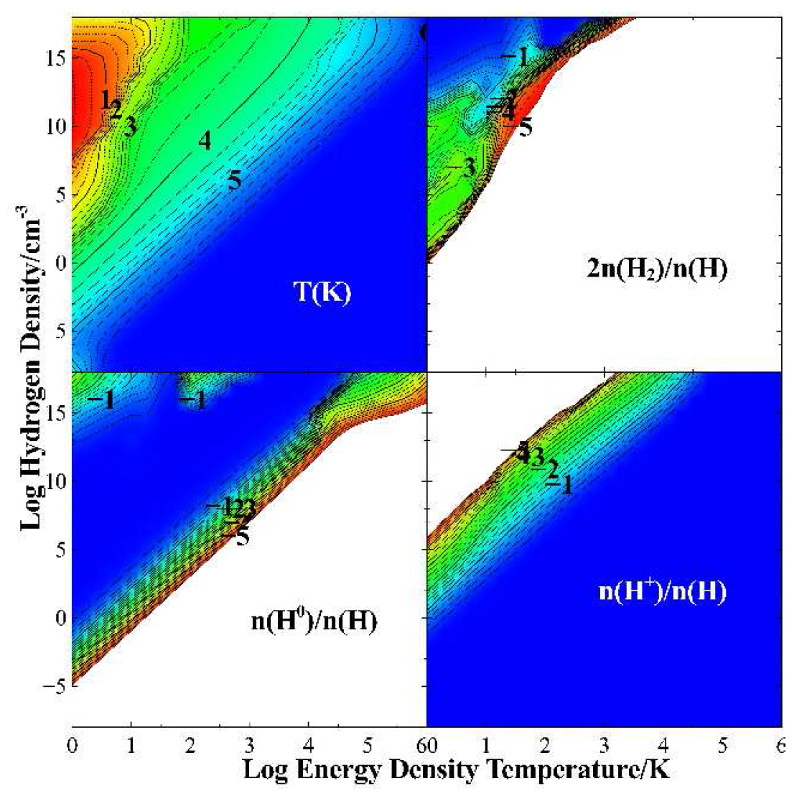

Slide 6
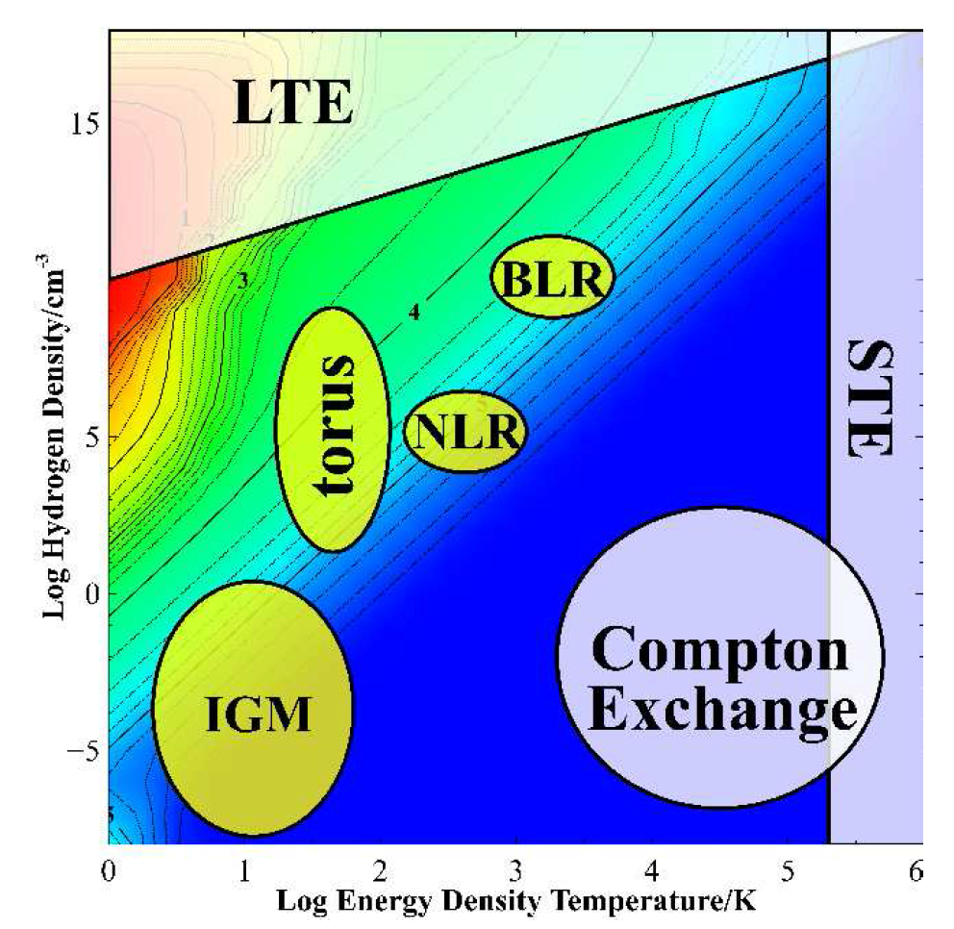

Slide 7
Open source since 1978
All versions, all data, on svn at nublado.org
You are most welcome to help!

Slide 8
Minimum to run Cloudy
Must specify
SED – shape of the radiation field
Flux of photons per unit area
Gas density
May specify
Gas composition, grains (grain-free solar by default)
Gas equation of state (often constant density)
Stopping criterion, often physical thickness

Slide 9
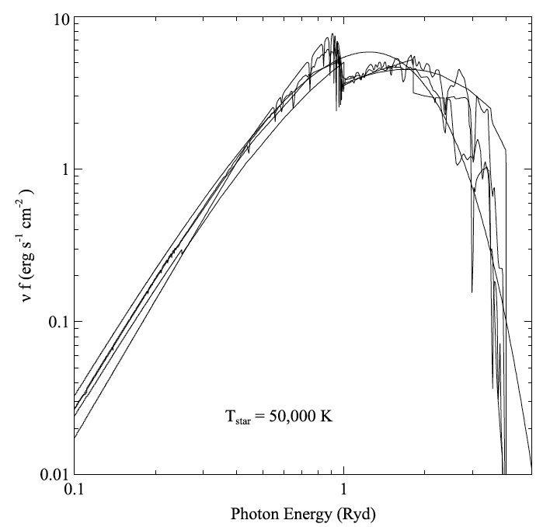
Parameters – the SED
Quick start guide Chapter 5
Hazy 1, Chapters 4, 6
Can be specified as a fundamental shape such as a blackbody
Generally entered as table of points

Slide 10
SED brightness – the intensity case
Specify ϕ(H) – photons per unit area
The “intensity case”
predicts emission per unit area
Inner radius of cloud does not need to be specified
Notes:
Show cartoon of cylinder viewed edge on, ray through it, limb brightening

Slide 11
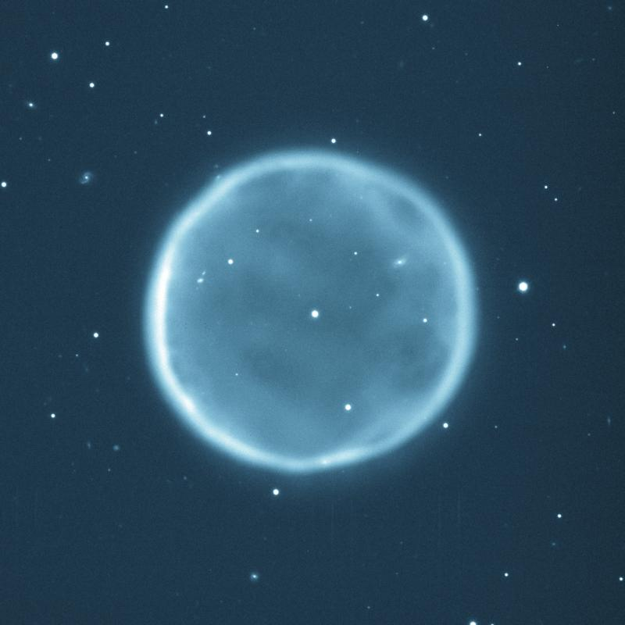
SED brightness – the luminosity case
Specify Q (H) – photon luminosity
Inner radius of cloud must be specified, since φ(H) = Q(H) / 4π r²
predicts emission line luminosities

